Slide 1
Autonomous Vehicles and Disengagements
Data 201 Capstone I
Jed Hsu

Slide 2
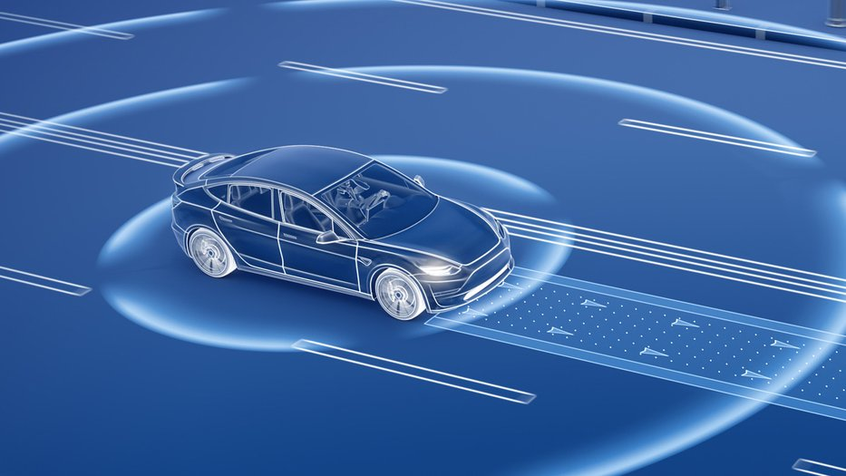
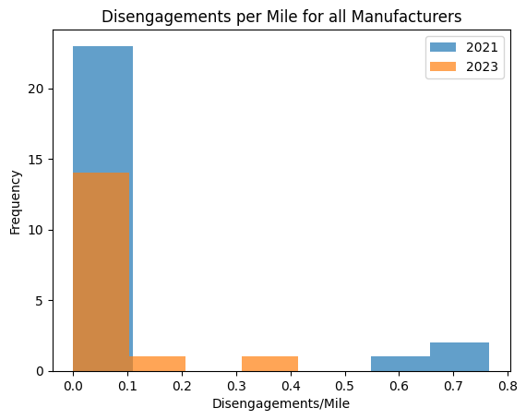
Summary
This study reviews the frequencing of autonomous vehicle disengagements over time to show autonomous technology is improving.
After the data analysis, autonomous vehicle disengagements over time did not decrease from 2021 to 2023 in California.
Depiction of an autonomous vehicle.¹
Histogram of autonomous vehicle manufacturers’ disengagements while in autonomous driving mode. The disengagements is normalized per miles driven in a year.
¹Image source: https://caltechsites-prod.s3.amazonaws.com/scienceexchange/images/Autonomous_Systems.2e16d0ba.fill-933x525-c100.jpg

Slide 3
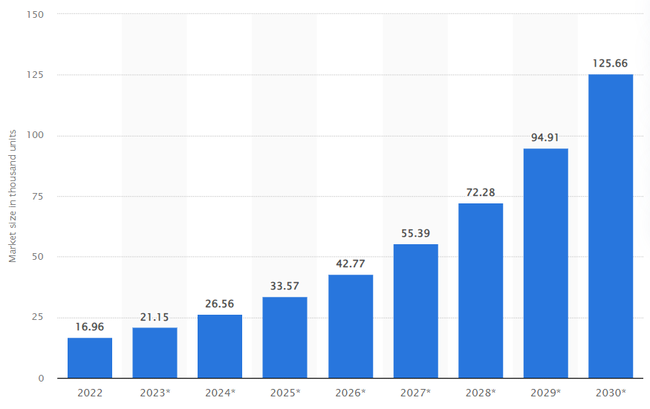
Background
Human errors account for 94-96% of vehicle collisions in the United States.²
Autonomous vehicles would be a solution for safer vehicles, and the autonomous vehicle sales are projected to increase over time.³
This study reviews the number of autonomous vehicle disengagements over time in California to show that self-driving technology is improving.
Number of autonomous vehicles globally in 2022, with a forecast through 2030³
² Source: NHTSA. Retrieved from https://crashstats.nhtsa.dot.gov/Api/Public/ViewPublication/812456
³ Source: Statistica. Retrieved from https://www.statista.com/statistics/1230664/projected-number-autonomous-cars-worldwide/

Slide 4
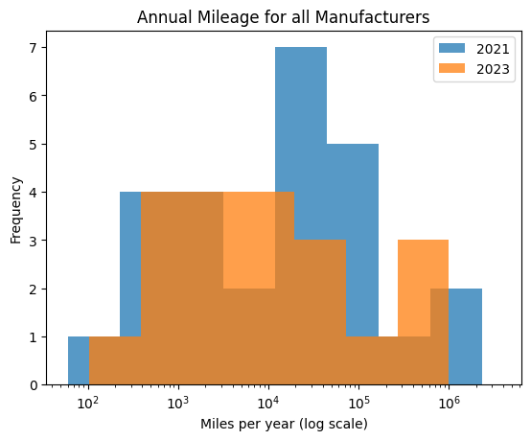
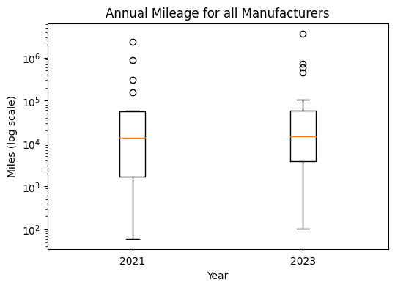
Exploratory Data Analysis
Data set: CA DMV Autonomous vehicle mileage and disengagements in 2021 and 2023
Data Cleaning:
Removed all erroneous commas and spaces
Converted date from string into date format
Grouped mileage driven by auto manufacturer
Reviewed annual total miles driven in 2021 and 2023
Histogram of mileage driven for autonomous vehicle manufacturers in California in years 2021 and 2023
Box plot of mileage driven for autonomous vehicle manufacturers in California in years 2021 and 2023

Slide 5
Results and Conclusion
A T-test study of years 2021 to 2023 indicated a 51% confidence the amount of autonomous disengagements per miles driven have decreased from 2021 to 2023.
This confidence level is insufficient to show this is true.
Histogram of autonomous vehicle manufacturers’ disengagements while in autonomous driving mode. The disengagements is normalized per miles driven in a year.
Conclusion: Autonomous vehicle disengagements from 2021 to 2023 in California have not been reduced

Slide 6
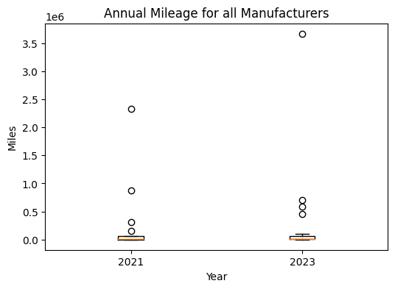

Reflection and Recommendation
The sample size for autonomous vehicle companies was low for this study.
Recommendation for next steps:
Compare other metrics that indicate autonomous vehicles are improving over time, such as frequency of collisions of autonomous versus human driven vehicles
A T-test can be used to compare the frequency of collisions
Use a different method for comparison instead of average. A few manufacturers had significantly more mileage, so averaging may have skewed the results.
Using weighted averages may resolve this.
A boxplot of the annual mileage with the y-axis on the linear scale. There are a few outliers for annual mileage which may have affected the study results.

